Slide 1
USER INTERFACE DESIGN
TITLE
COMPLAINT MANAGEMENT SYSTEM
SUBMITTED BY:
APARNA V – 20ITR009
GOKUL SHANKAR K P – 20ITR027

Slide 2
COMPLAINT MANAGEMENT SYSTEM
THEME:
1. The web application is designed to perform CURD operations.
2. Here a person can register a complaint.
3. Delete the complaint
4. Edit the complaint
5. Update if the complaint has been solved

Slide 3
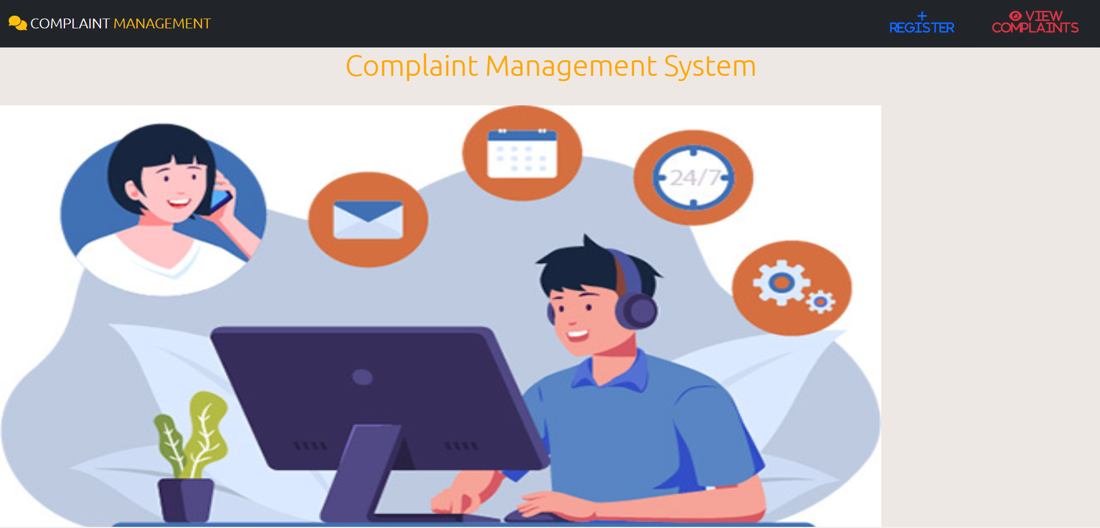
COMPLAINT MANAGEMENT SYSTEM
HOME PAGE

Slide 4
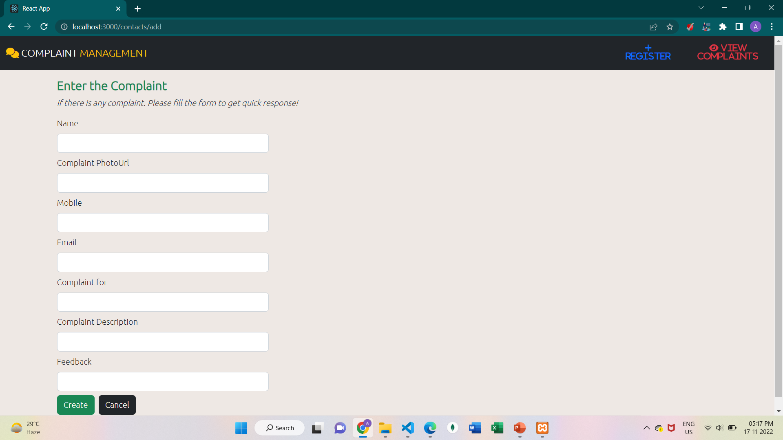
COMPLAINT MANAGEMENT SYSTEM
REGISTER

Slide 5
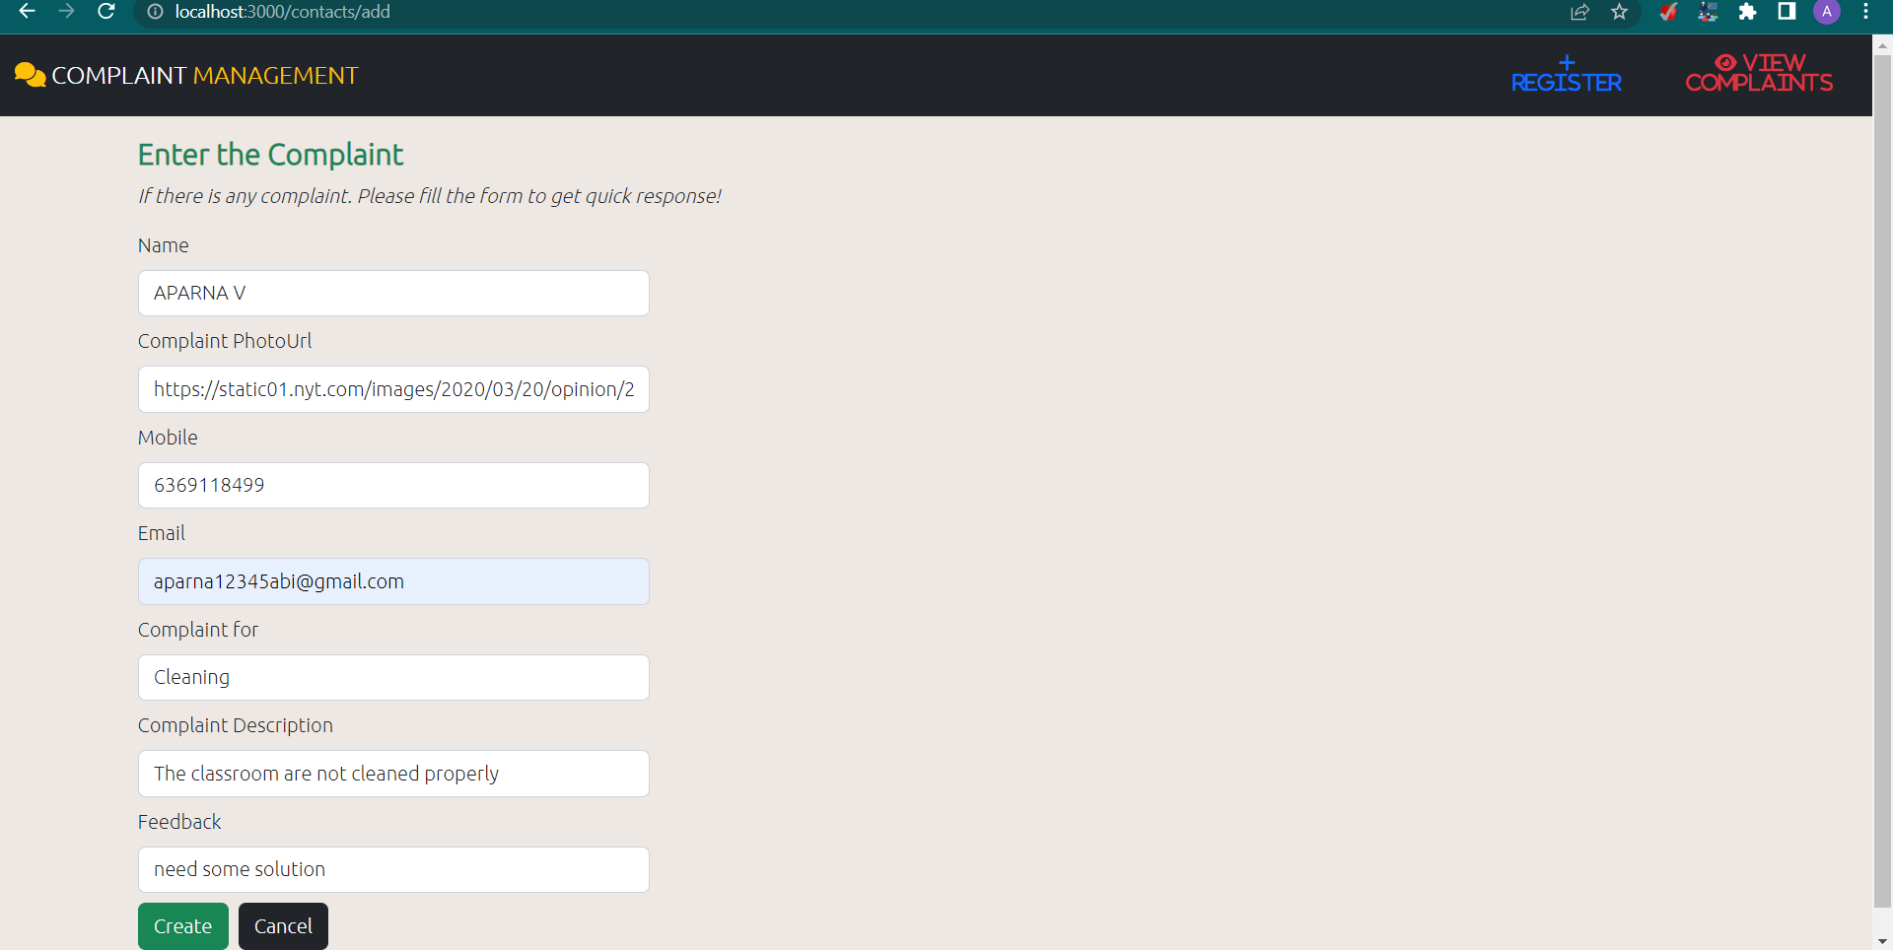
COMPLAINT MANAGEMENT SYSTEM
AFTER ENTERING DETAILS IN REGISER PAGE

Slide 6
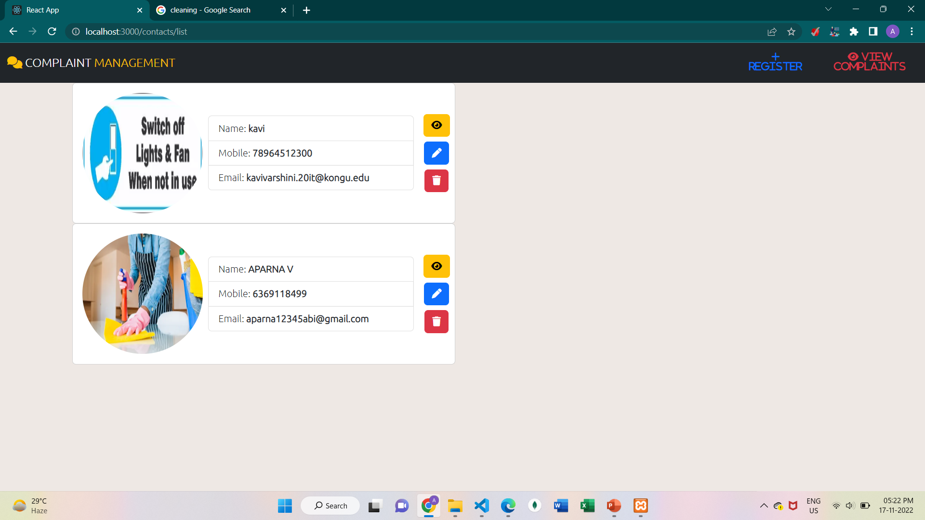
COMPLAINT MANAGEMENT SYSTEM
LIST PAGE

Slide 7
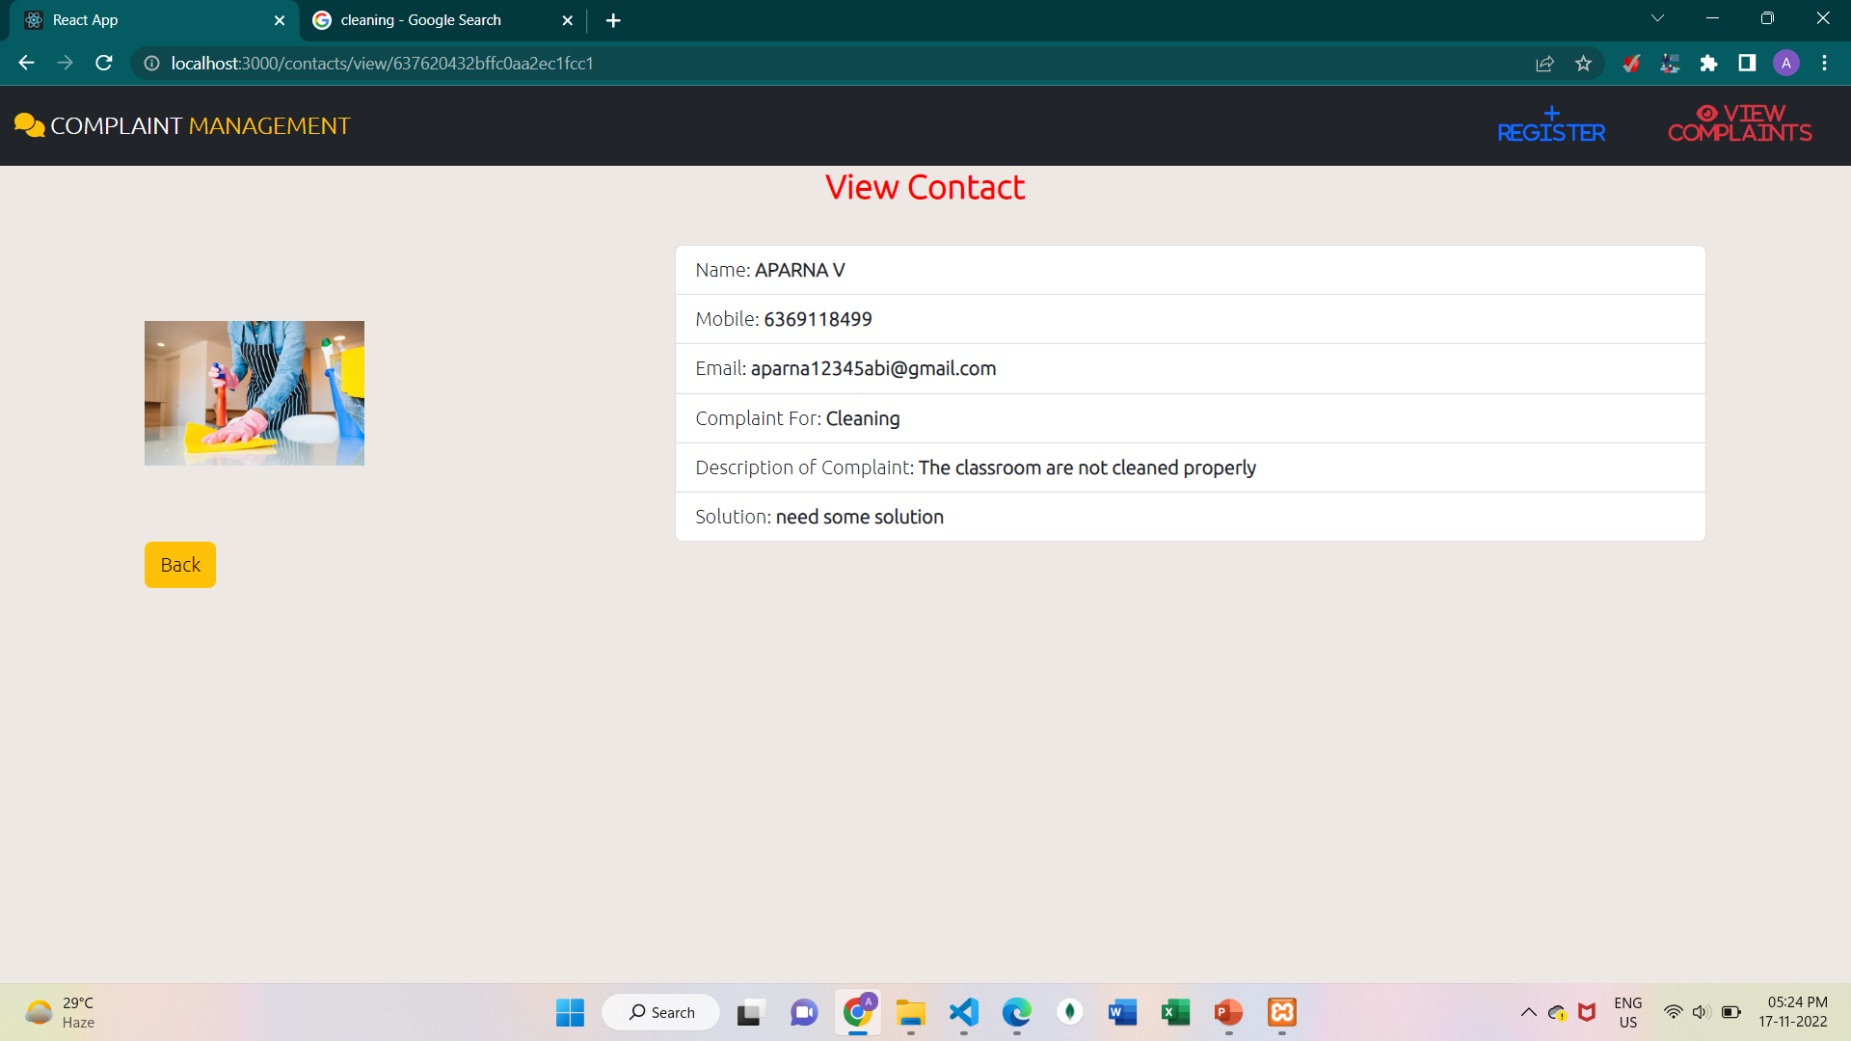
COMPLAINT MANAGEMENT SYSTEM
VIEW THE DETAILS

Slide 8
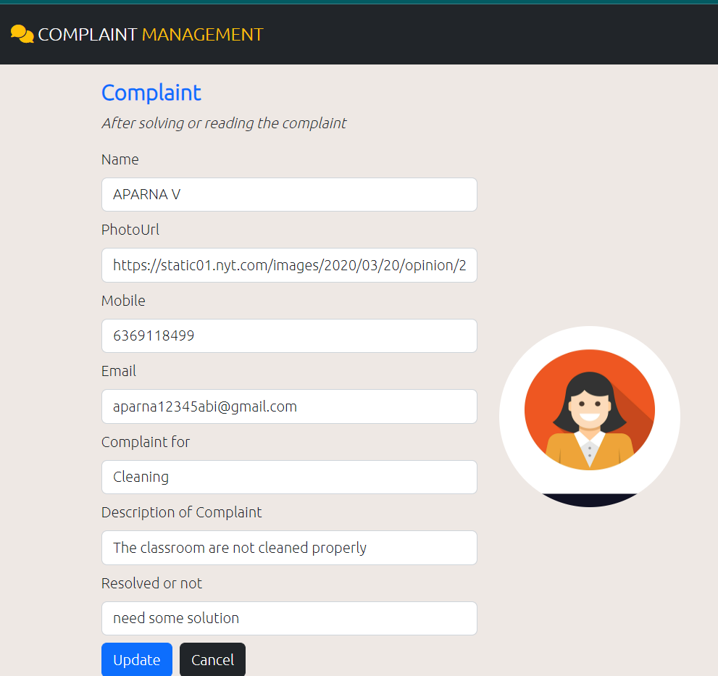
COMPLAINT MANAGEMENT SYSTEM
BEFORE UPDATING

Slide 9
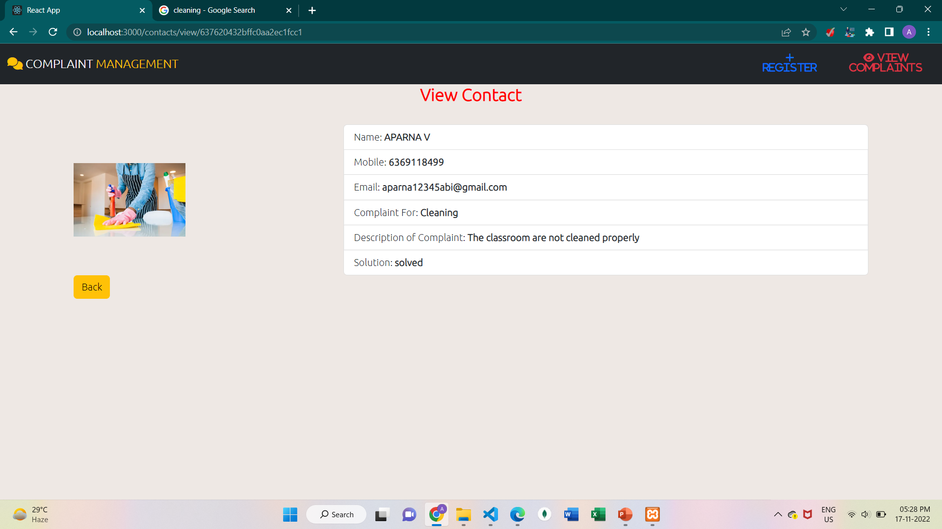
COMPLAINT MANAGEMENT SYSTEM
AFTER UPDATING

Slide 10
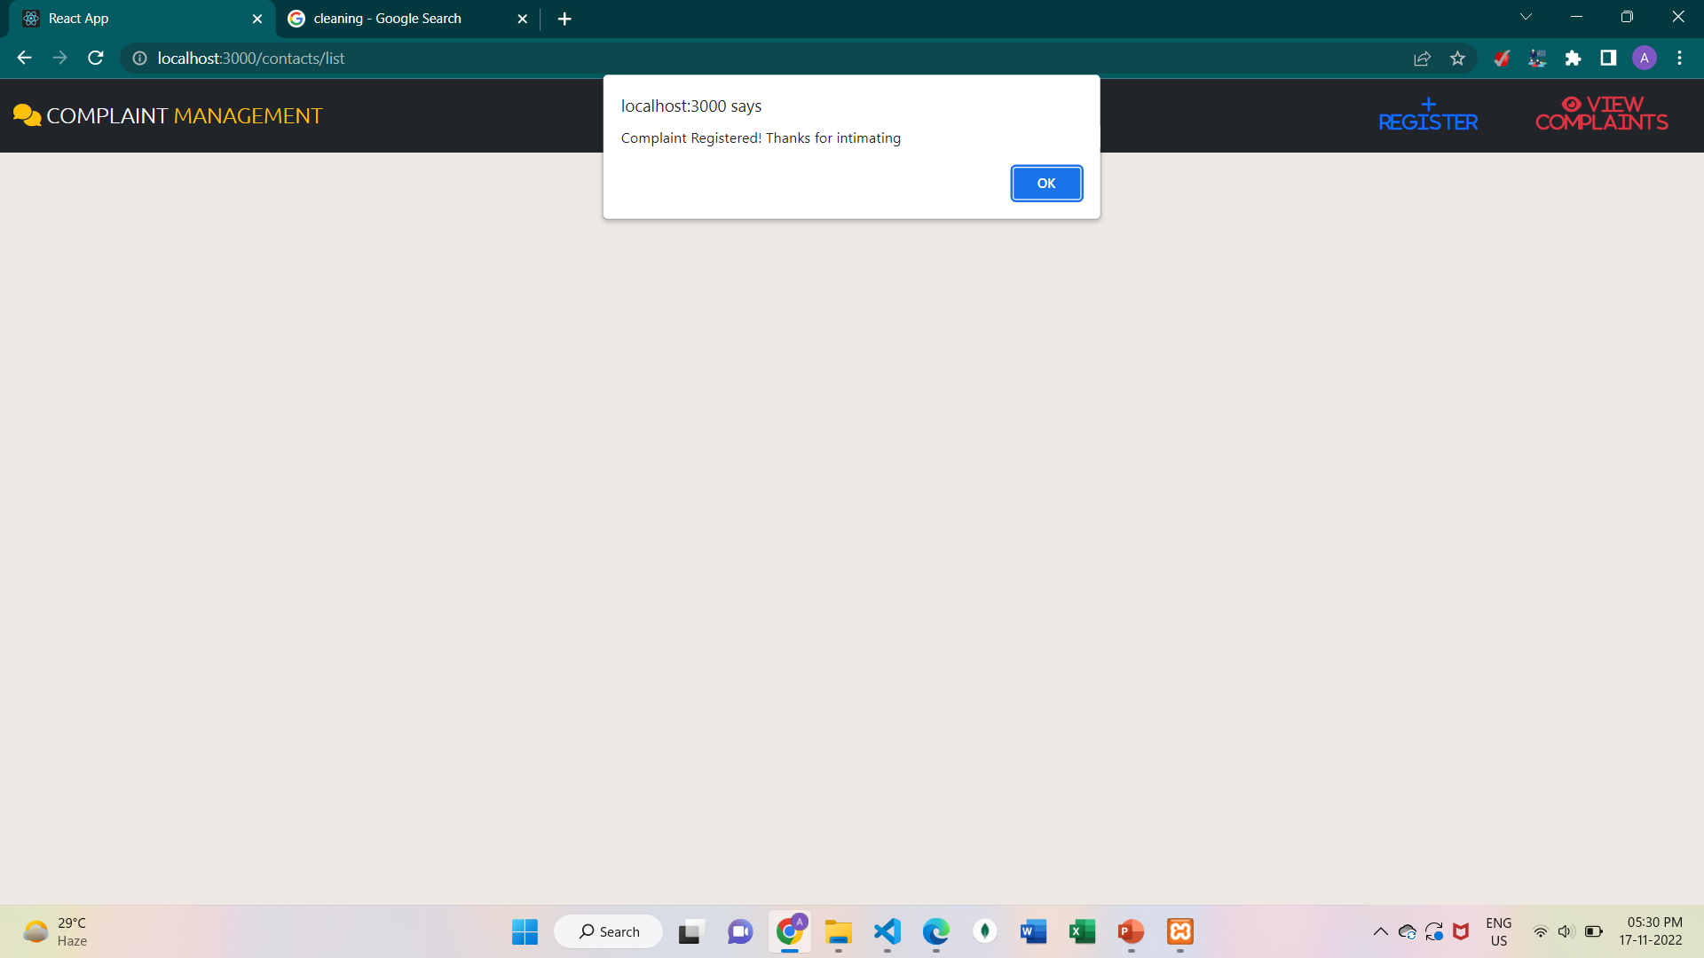
COMPLAINT MANAGEMENT SYSTEM
DELETING A COMPLAINT

Slide 11
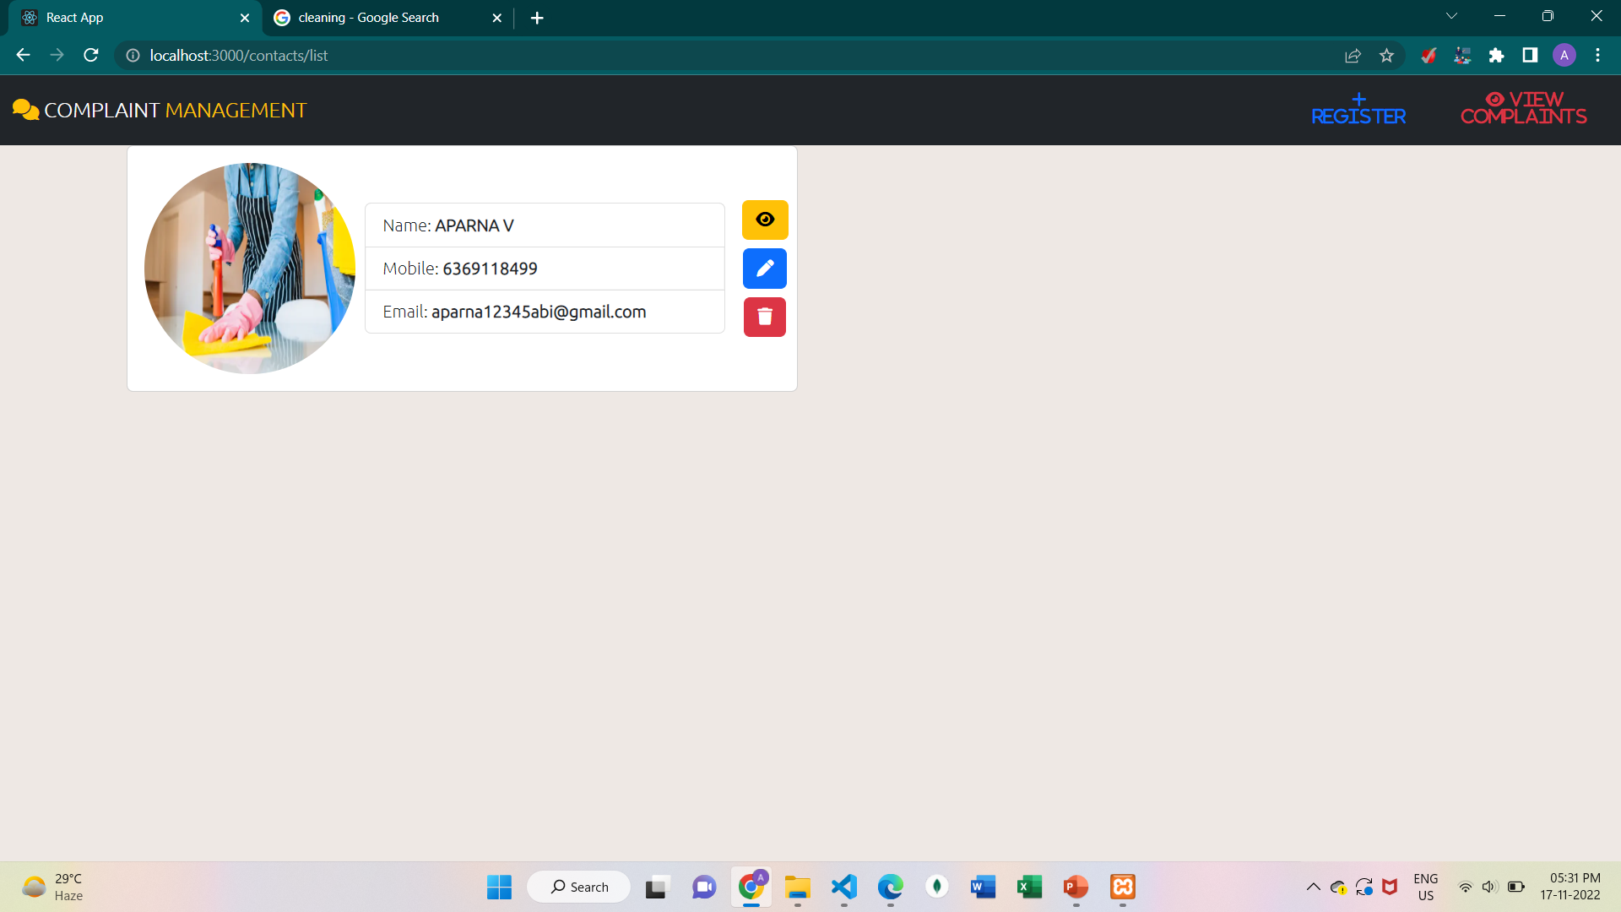
COMPLAINT MANAGEMENT SYSTEM
AFTER DELETING

Slide 12


